Slide 1

Designing Algorithms for Deciphering Dependencies between Stock Prices
^{The BTech Project of}
Anirudh Bajaj (B20CS013) and Diksha Jena (B20CS005)
^{Mentor: Dr Saptarshi Pyne}
Department of Computer Science and Engineering Indian Institute of Technology Jodhpur, Rajasthan, India 342030
December 6, 2023

Slide 2
Objective
Among the stock traders, it has become popular to forecast the price of a stock based on its past prices [1].
In this project, we aim to explore whether deciphering the interdependencies between a group of stocks can provide us with more nuanced stock price predictions.

Slide 3
Data collection
We selected 49 of the largest companies on the NIFTY 50 benchmark index of the National Stock Exchange, India.
Their daily closing prices were downloaded for the following decade. Start date: January 1, 2011 End date: December 31, 2020

Slide 4
Data preprocessing
Some of the stocks had been renamed due to acquisitions, e.g., ‘Mundra Port’ had been renamed to ‘Adani Ports’ in January 2012.
We identified such changes and replaced all different names with a single name.
We also checked for missing values but no missing values were found.

Slide 5
Data discretisation
For each stock, we discretised its daily prices into two levels
- Level 0 if the price was below median (the stock was undervalued; hence, good time to buy it)
- Level 1 if above or equal to median (the stock is overvalued or in its true value range; not a good time to buy it)

Slide 6
Creation of the training and test data
We split our 10-year dataset into 9:1 subsets.
Training data:
January 1, 2011 – December 31, 2019 (2,226 trading days * 49 stocks)
Test data:
January 1, 2020 – December 31, 2020
(252 trading days * 49 stocks)

Slide 7
Methods: Quantification of interdependencies
We computed a (49 x 49) dependency matrix where the (i, j)-th cell represents the influence of the the j-the stock’s price on the i-th stock’s price
= (The number of days when i and j both went up or both went down - The number of days when they went in the opposite direction) / The total number of days in the training data.
Here, ‘up’ refers to going from level 0 in the previous day to level 1 in the current day. ‘Down’ refers the opposite incident.
The dependency matrix is asymmetric since j may have more influence on i than i have on j.
Influencer
 | MUNDRAPORT | ASIANPAINT | AXISBANK | BAJAJ-AUTO | …
MUNDRAPORT | 1 | 0 | 0 | 0.085714286
ASIANPAINT | 0 | 1 | 0 | 0
AXISBANK | 0 | 0 | 1 | 0
BAJAJ-AUTO | 0.12 | 0 | 0 | 1
…
The influence weights belong to the range [0, 1]. The diagonal is always 1.
Influenced

Slide 8
Methods: Prediction based on interdependencies
For each stock i
f[i] = The fraction of days when i is at level 1 across all the training days.
For each test day k = 0 to 252
temp = ⅀_{j}((dependency_matrix[i][j])*(f[j])) / ⅀ _{j} (dependency_matrix[i][j]);
if temp > f[i]
predicted level = 1;
else
predicted level = 0;
f[i] = f[i] + (predicted level – level of i on the k-th training day)/(Total number of training days)
Why are we doing the last line?

Slide 9
Evaluation metrics
Euclidean Norm
F1 Score
Dependency Graphs
It quantifies the magnitude of the error, providing a numerical representation of the model's accuracy. A lower Euclidean norm suggests that the predicted values closely align with the actual prices.
F1-score considers both precision and recall, offering a balanced assessment of a model's ability to make good predictions. It is applied here to assess the method's performance in correctly identifying changes in stock prices.
To get a clear picture of which all stocks a particular stock depends on, and by how much. The importance to its own stock is given as 1 and the rest of weights are calculated as a (positive / negative) ratio of that one.

Slide 10
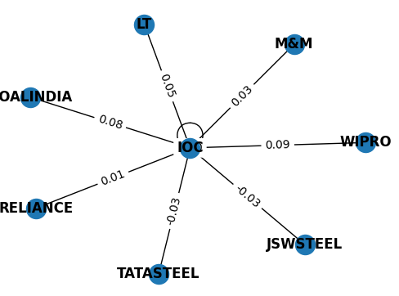
Evaluation
Euclidean norm :
For entire dataset
Predicted data: 76.7333043730035
Test data: 77.27871634544663
Similarity: 99.3%
Stock-wise average
Predicted data: 8.803807791
Test Data: 9.255634165
Similarity: 95.11%
F1 score :
For entire dataset: 0.49106239460371
Stock-wise average: 0.286785462
Dependency graph of IOC (Indian Oil Corp.)

Slide 11
Summary and future work
We developed a novel pipeline for
- quantifying the dependencies between different stocks and
- utilizing this information for predicting their prices. (Code and data: https://github.com/spynegroup/DikshaAnirudhNifty)
In future, we would like to compare the goodness of our prediction with that of the alternative algorithms such as the long short-term memory (LSTM).

Slide 12
References
Yi Zuo, Masaaki Harada, Takao Mizuno, and Eisuke Kita : Bayesian Network Based Prediction Algorithm of Stock Price Return (2012)
Ward, J. H. (1963). Hierarchical Grouping to Optimize an Objective Function. Journal of the American Statistical Association, 58(301), 236–244.
Koller, Daphne : Probabilistic Graphical Models
Box, G., Jenkins, G.M., Reinsel, G.C.: Time Series Analysis: Forecasting and Control. Prentice-Hall (1994)
Pearl, J., Russell, S.: Bayesian networks. In: Arbib, M.A. (ed.) Handbook of Brain Theory and Neural Networks, pp. 157–160. MIT Press (2002)
Cooper, G.F., Herskovits, E.: A Bayesian method for the induction of probabilistic networks from data. Machine Learning 9(4), 309–347 (1992)

Slide 13
Thank you

Slide 14
Introduction
This report describes a new approach for predictions of stock price return. In this approach, the closing prices of all the NIFTY stocks is discretized to binary values and then the dependencies between any two stocks is calculated and represented via a directed acyclic graph. The stock price is determined from the dependency values and discrete value set of the stock prices through a time-series. Finally, this algorithm provided the predictions with a nearly similar norm (~99.3%) as of the actual discretized value.

Slide 15
Background Research
Time Series Models
Bayesian Probability
Structural Learning
Tesla Discretization

Slide 16
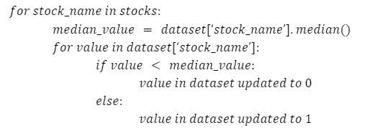
Model Structure : Discretization
For discretization, the closing prices of each stock are divided into two clusters with respect to the median of closing prices of that stock and the closing prices of a particular stock which are lower than the median price of that stock are given a value ‘0’ to them and those whose value of closing price is higher than the median price are assigned a value of ‘1’.

Slide 17
Data collection
Dataset
For our experimentation, the Nifty-50 stock market data is used. It had the price history and trading volumes of the fifty stocks in the index NIFTY 50 from NSE (National Stock Exchange) India spanning from 1st January, 2000 to 30th April, 2021. All dataset is split across .csv files for each stock metadata file with some macro-information about the stocks itself.
Preprocessing
Data Compilation
Focus on Relevant Information
Handling Name Changes
Addressing Missing Values
Common Date Range
Data Presentation

Slide 18
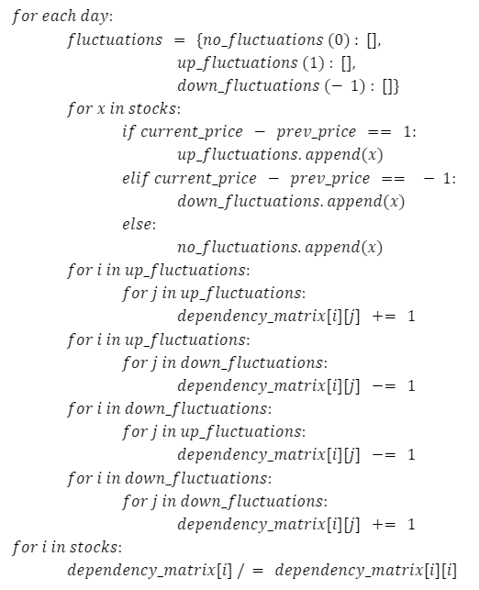
Model Structure : Dependency Metric
Each value in the dependency matrix stores the factor of dependency of a stock on another stock. For each pair of stocks (‘i’ and ‘j’), dependencies (dependency_matrix[i][j]) are calculated by identifying the number of updates in a stock in favor or against with respect to the change in another stock. For eg. if the value of a base stock (i) is updating from 0 to 1, then for each of the other stocks, if update in their value is in favor of this update, i.e., from 0 to 1, therefore, the dependency increases by a unit fraction of total updates in the value of the base stock (i) and if update in their value is against this update, i.e., from 1 to 0, then the dependency decreases by a unit fraction of total updates in the base stock (i). From this, it can be concluded that the range of dependency_matrix[i][j] is [-1,1].

Slide 19
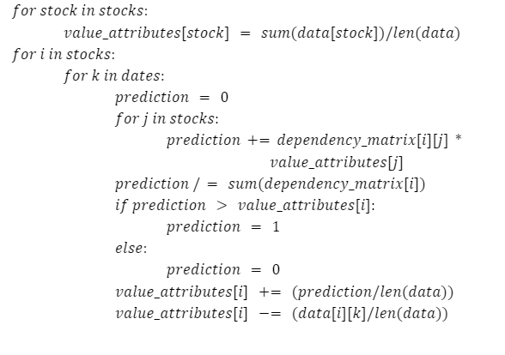
Model Structure : Sampling
predicted_value[i] = ⅀_{j}(dependency_matrix[i][j])*(value_attributes[j])
/ ⅀ _{j} (dependency_matrix[i][j])

Slide 20
Methodology
Simplify the NIFTY stock prices by converting them into binary values, making it easier to analyze without sacrificing interpretability. The goal is to enhance clarity in understanding stock relationships. By using binary representation, the analysis is kept practical and effective, ensuring that essential information about stock dynamics is preserved. The approach of employing median values for data division and conversion helps maintain up-to-date and accurate reflections of current profitability standings. This is crucial for stability amid market fluctuations.
Calculate dependencies between any two stocks. This is achieved by checking for updates in values, specifically from 0 to 1 or from 1 to 0. These dependencies are then visually represented through a directed acyclic graph, providing a clear illustration of the relationships between different stocks.
After transforming the closing prices of NIFTY stocks into binary values and calculating dependencies between them, the next crucial phase involves determining the stock price. This determination is achieved by taking into account both the identified dependencies and the discrete value set of stock prices over a specified period of time. The result of this process is a time-series dataset that effectively captures the evolution of stock prices.

Slide 21
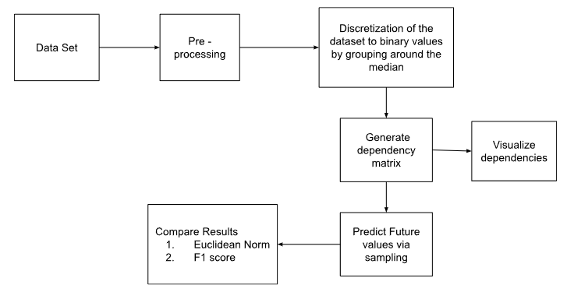
Code Structure

Slide 22
Applications
Portfolio Management: The model can be utilized in portfolio management to optimize the allocation of assets, balancing risk and return based on the predicted stock price movements.
Stock Price Forecasting: The primary application is predicting future stock prices, providing investors and financial analysts with insights into potential market trends and aiding in strategic decision-making.
Algorithmic Trading: The model's predictions can be integrated into algorithmic trading systems to automate buy or sell decisions, capitalizing on market trends and executing trades with minimal human intervention.

Slide 23
Limitations
Cannot predict the exact stock price
Predicts only the closing price of a stock
Assuming non-closure of a company
Incomplete Information
Regulatory Changes
Human Factor

Slide 24
Future Scope and Extensions
Exact Price Prediction: Developing strategy to predict the exact price of stock instead of only predicting the nature of stock price.
Dynamic Model Adaptation: Developing mechanisms to allow the model to dynamically adapt to changing market conditions and trends, ensuring its relevance and accuracy in different economic environments.
Incorporating Sentiment Analysis: Integrating sentiment analysis from news articles, social media, or financial reports to capture market sentiment and investor behavior, providing a more comprehensive understanding of factors influencing stock prices.
Real-Time Data Feeds: Implementing real-time data feeds to ensure that the model is continuously updated with the latest information, enabling more timely predictions and responses to market changes.

Slide 25
Conclusion
This method streamlines NIFTY stock prices by converting them into binary values, ensuring practicality without compromising essential interpretability. The utilization of median values for data division maintains current and accurate reflections of profitability standings, crucial for stability amid market fluctuations. Following the calculation of dependencies and their visualization through directed acyclic graphs, the determination of stock prices integrates identified dependencies and discrete values over time, forming a comprehensive time-series dataset. This dynamic record facilitates a profound analysis of evolving stock prices, revealing intricate relationships and influences, ultimately offering a robust foundation for making well-informed investment decisions within the dynamic landscape of the NIFTY stock market.

